Slide 1
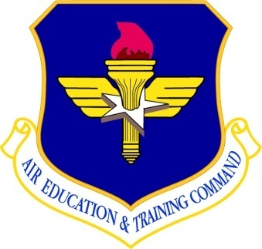
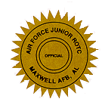
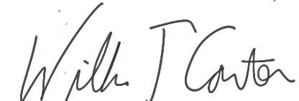
Air Force Junior Reserve Officer Training Corps
AIR EDUCATION
AND TRAINING COMMAND
This is to certify that
Dwight B. Holmes
is awarded this
Certificate of Completion
for
Completing 50 hours of
Air Force Junior ROTC Professional Development
at 2015 Eagle Challenge Leadership Development Course
Smith Mountain Lake, Virginia, July 26 – July 31, 2015
Date: 31 July 2015
CONTINUING EDUCATION CONTACT HOURS: 50
(TECHNOLOGY HOURS: 03)
WILLIAM T CARTER, LT. COL, USAF (Ret)
Commandant, Eagle Challenge LLA
AFOATS Form 308, 20000906

