Slide 1
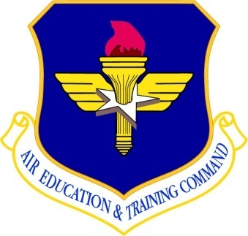
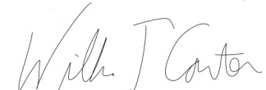
Air Force Junior Reserve Officer Training Corps
AIR EDUCATION
AND TRAINING COMMAND
This is to certify that
Cadet ???????????
is awarded this
2013 Eagle Challenge / LLA
Graduation Certificate
for
Successfully completing all course participation and evaluation requirements.
This leadership school was held at Smith Mountain Lake 4H Center, VA
HQ AFJROTC authorizes high school and college credit for course graduation.
WILLIAM T CARTER, LT. COL, USAF (retired)
Commandant
Eagle Challenge LLA
03 Aug 2013
AFOATS Form 308, 20000906

